Slide 1


ParkEase
An Urban Parking Solutions Mobile Application
Instructor : Dr. Ahmad Al-Najar
By : Mais Zahran , Anas Alseid

Slide 2
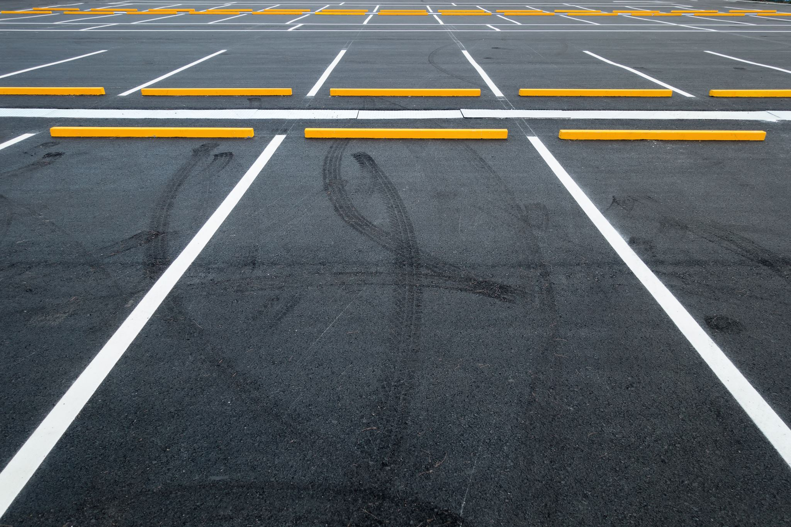
Welcome to ParkEase

Slide 3
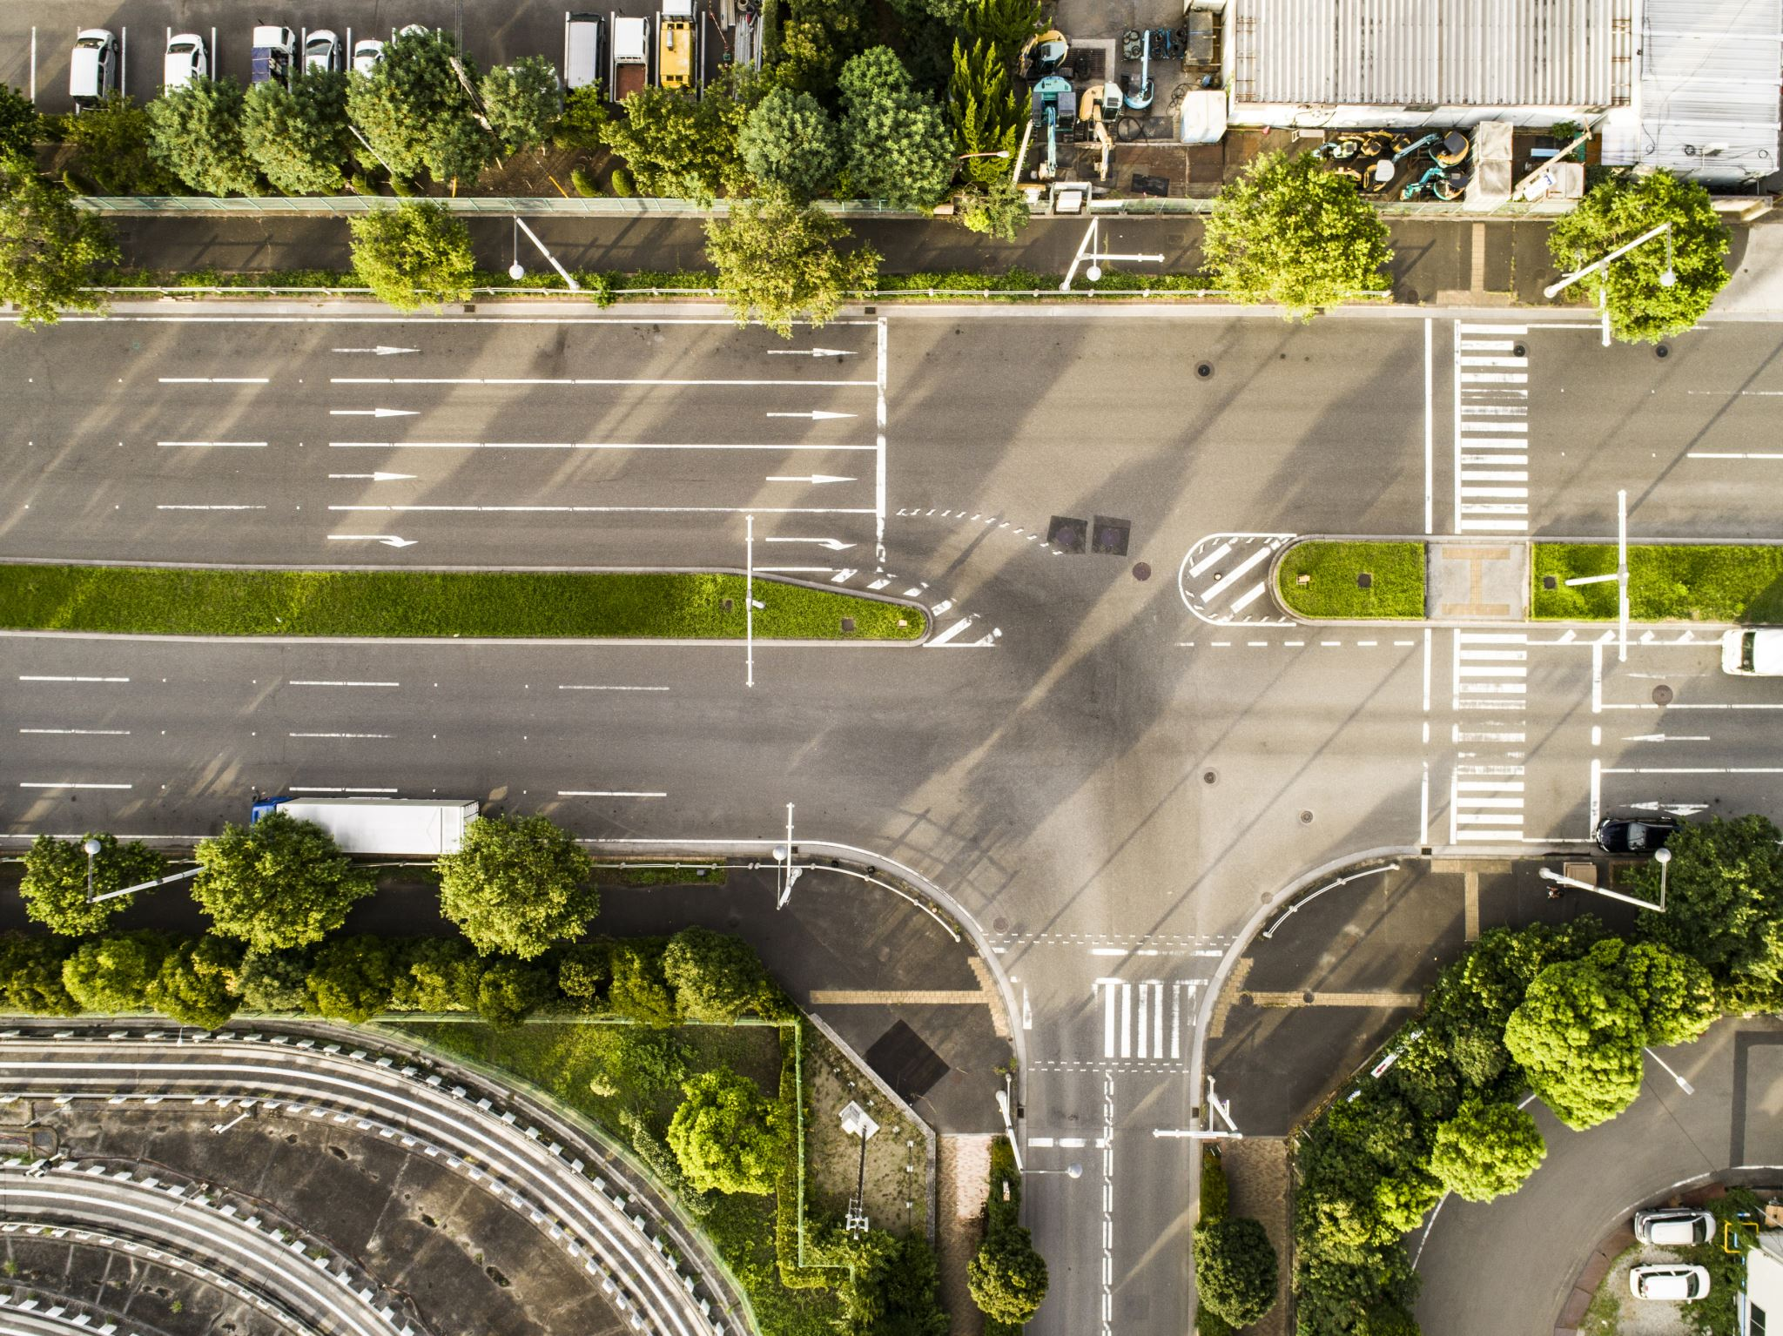
Problem Statement
Urban areas globally struggle with a scarcity of available parking spaces, resulting in heightened traffic congestion, driver frustration, and environmental pollution.

Slide 4
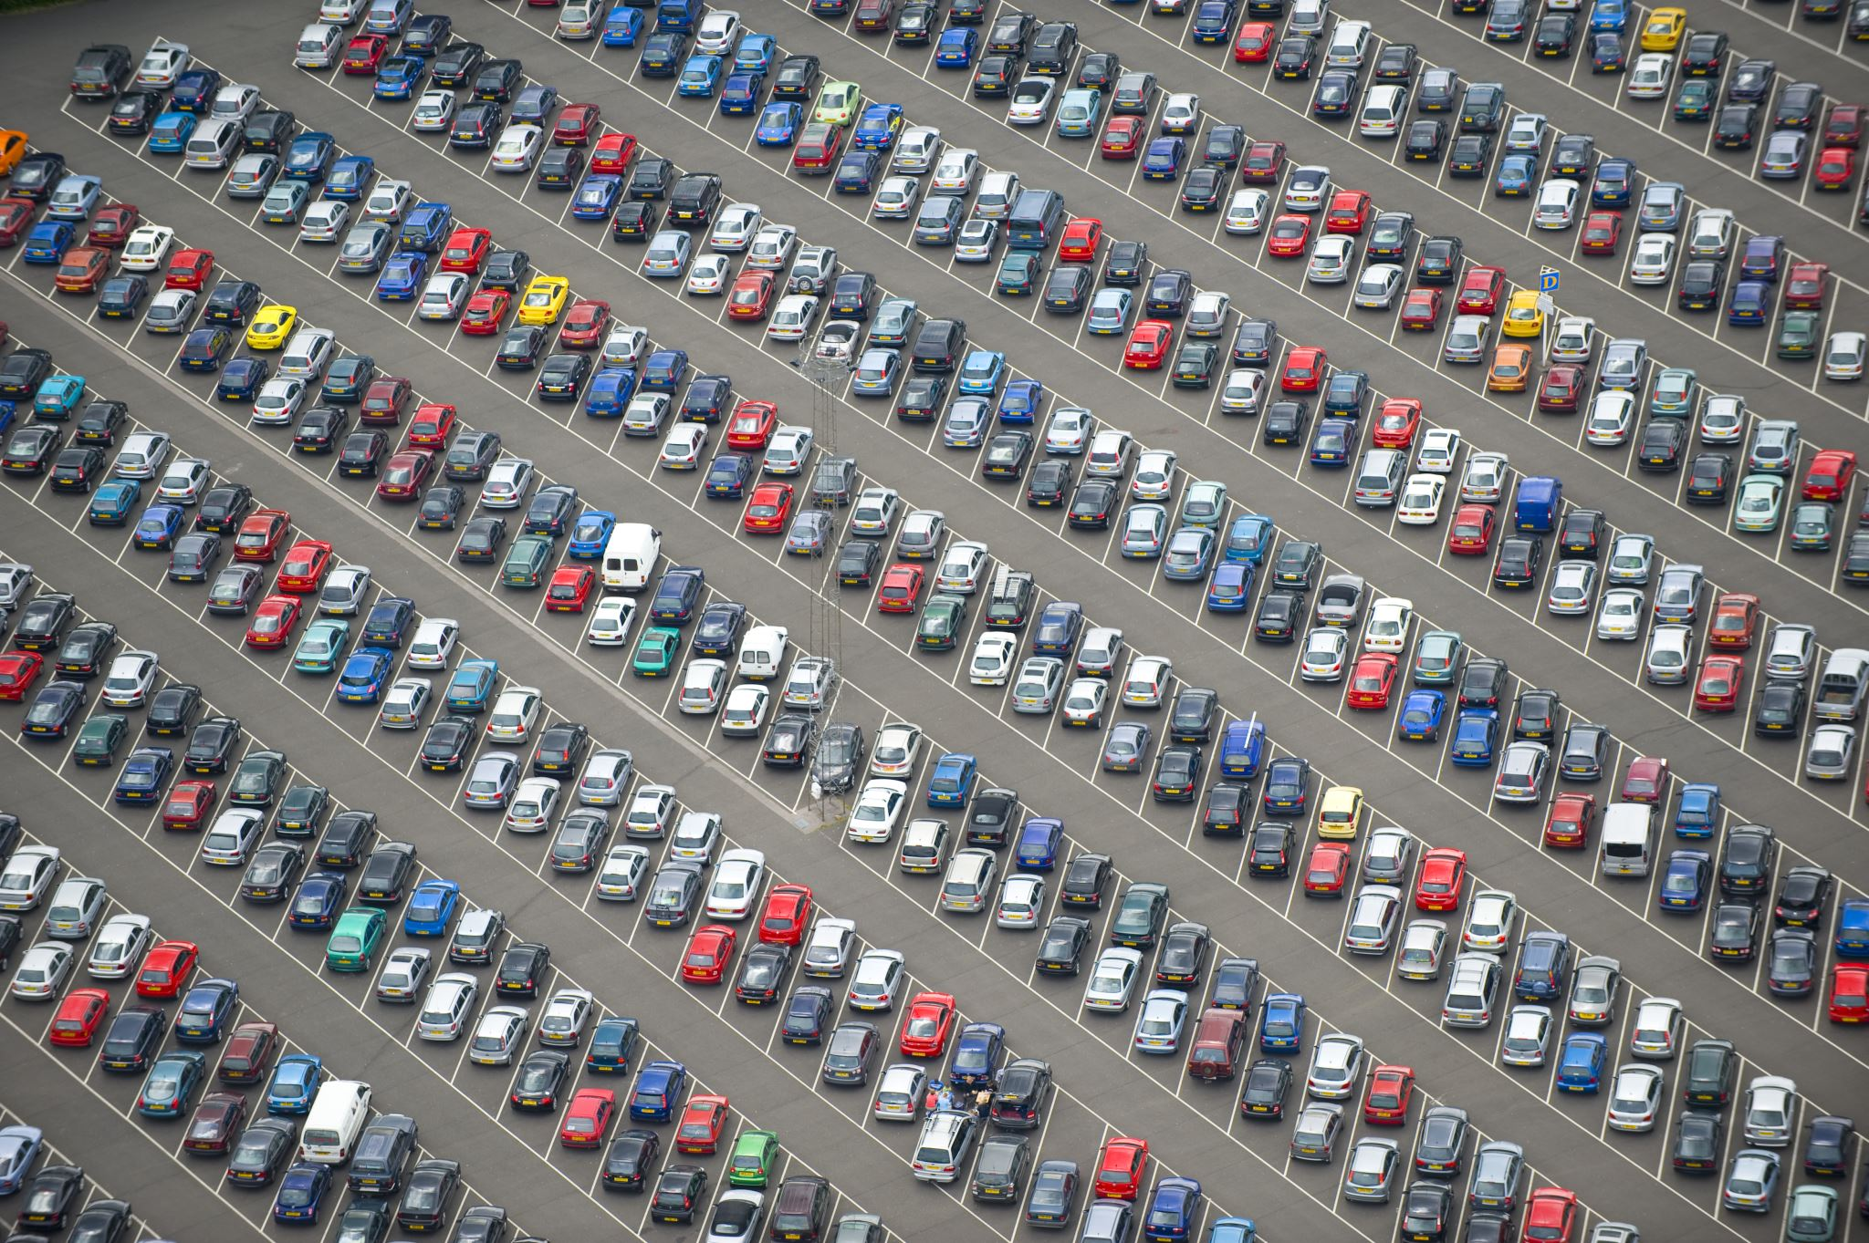
Project Scope and Objectives
Scope: Development of a cross-platform application featuring real-time parking and EV charging spot availability, reservation, and payment system.
Objectives:
1. Provide Real-Time Parking Information
2. Enable Reservation and Payment
3. Promote Electric Vehicle (EV) Usage
4. Reduce Parking Search Time
5. Offer Subscription Levels
6. Ensure Scalability
7. Maintain Security
8. Enhance Reliability
9. Promote Eco-Friendly Urban Driving
10. Foster User Engagement and Satisfaction

Slide 5
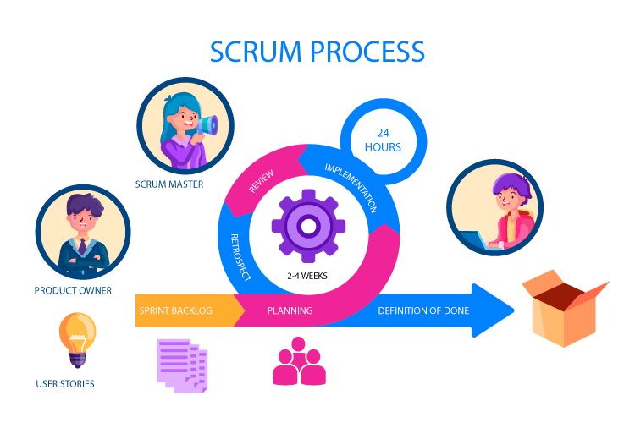
Methodology
The project will adopt the Agile development methodology, specifically utilizing the Scrum framework to allow for flexibility, rapid iteration, and continuous feedback throughout the development process.

Slide 6
Functional and Non-Functional Requirements
Functional Requirements:
1. User Authentication
2. Parking Spot Reservation
3. Subscription Service
4. Navigation Integration
5. EV Charging Spot Feature
6. Profile Management
7. Admin Management
Non-Functional Requirements:
1. Performance
2. Usability
3. Reliability
4. Scalability
5. Security
6. Compatibility
7. Maintainability
8. Localization

Slide 7
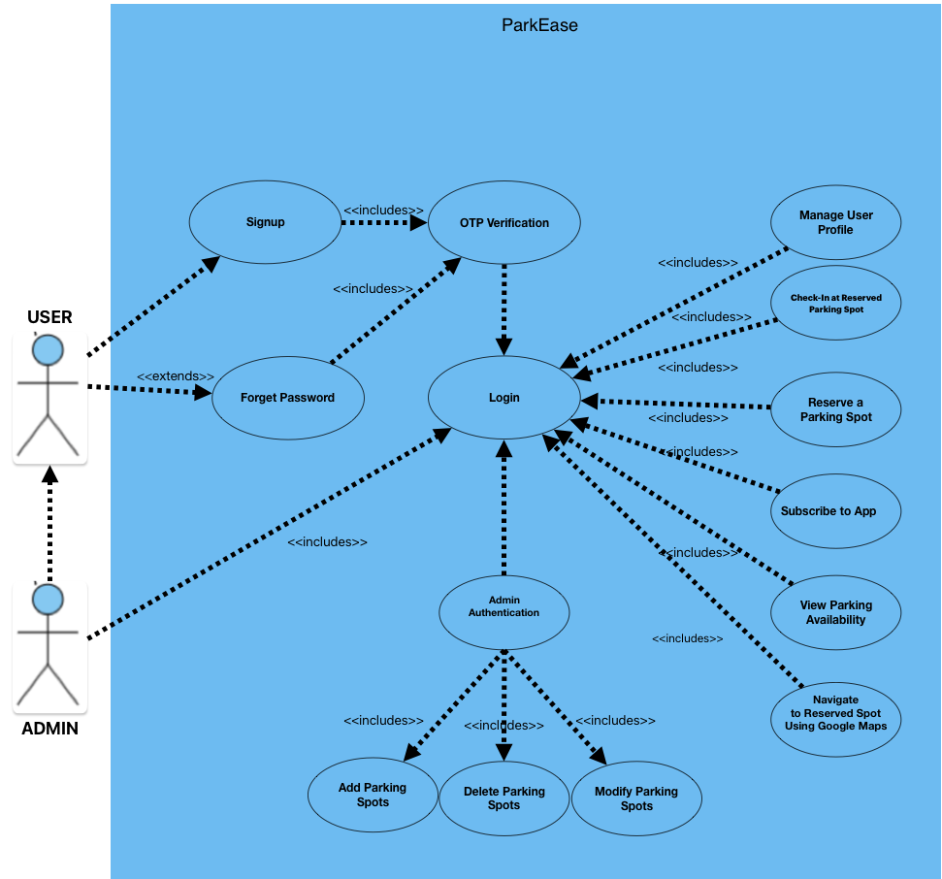
Use Case Diagram

Slide 8





Technologies and Tools
Frontend: Flutter
Backend: Node.js , MongoDB
Payment Integration: 2CheckOut
DevOps: GitHub
Authentication: JWT, Rapid SMS API
Development Tools: Postman, Jest
Monitoring: MongoDB Atlas Monitoring, Railway Metrics and Logs
Other Tools: Google Maps API

Slide 9
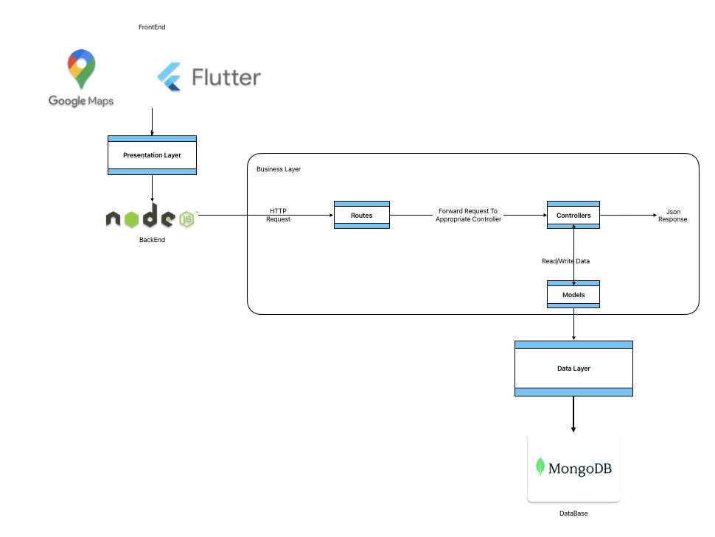
System Architecture
The architecture is composed of three primary layers—Presentation Layer, Application Layer (inclusive of Business Logic), and Data Layer.

Slide 10
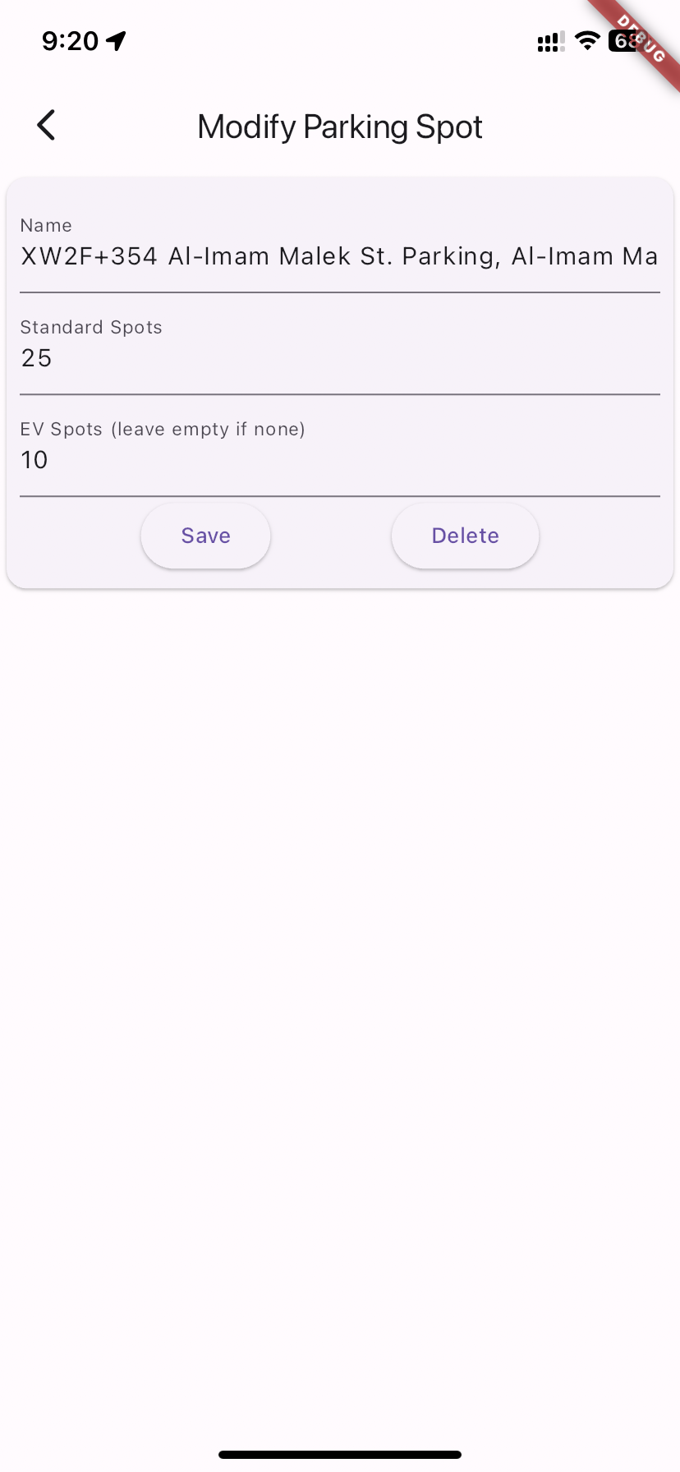
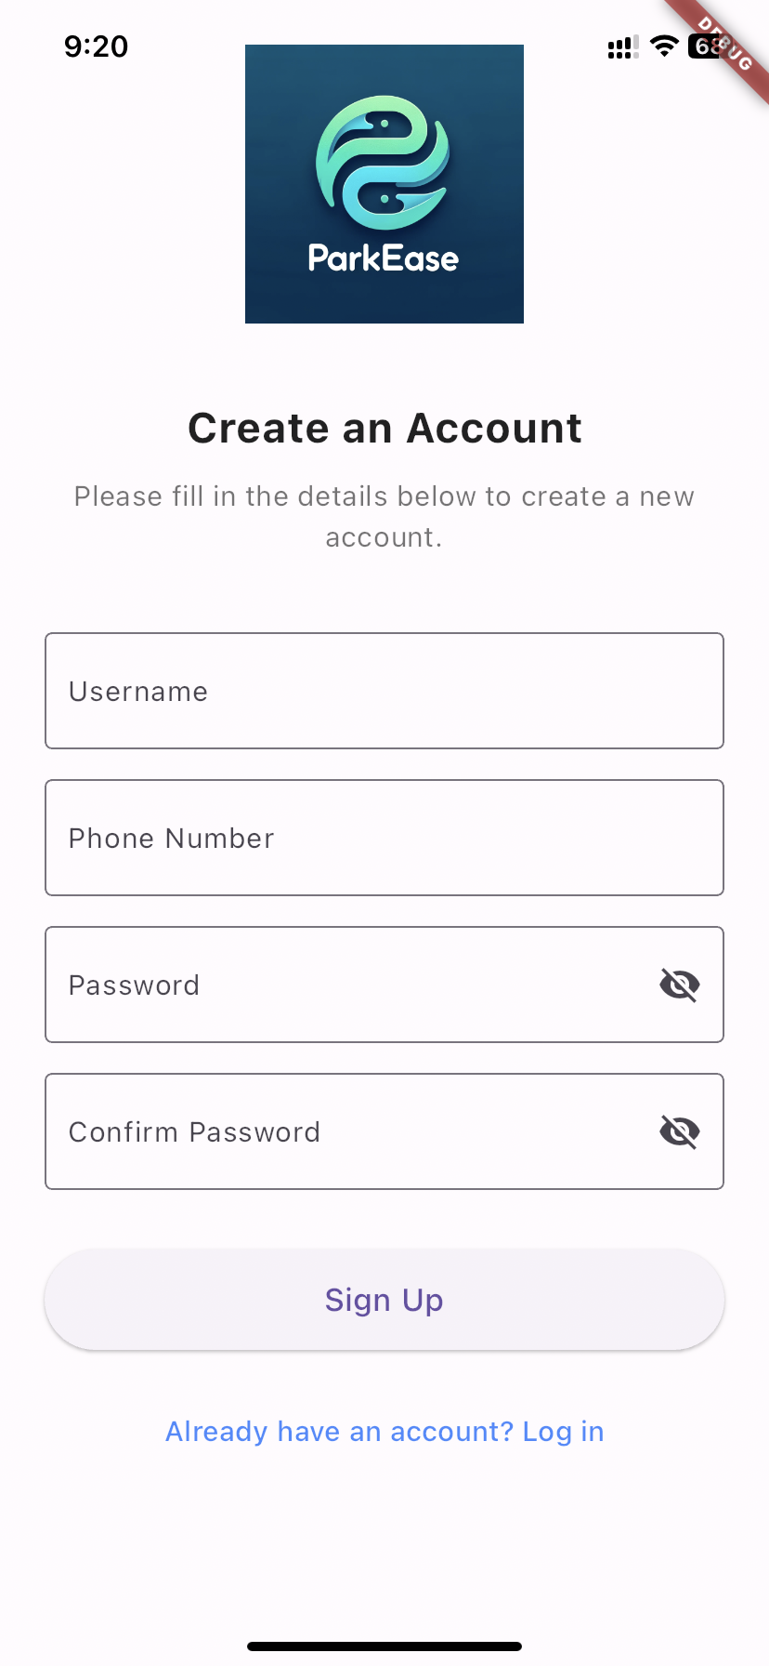
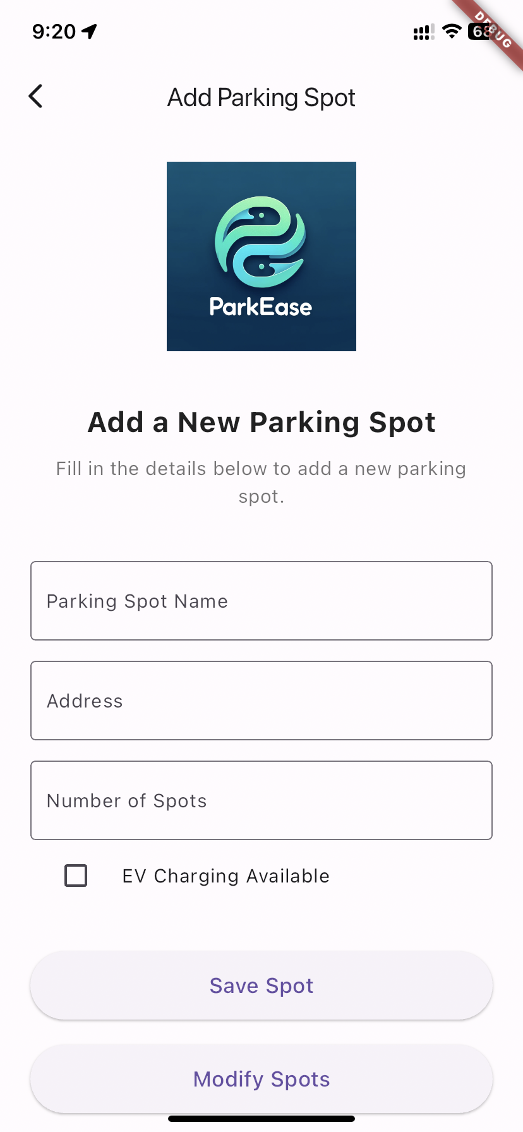
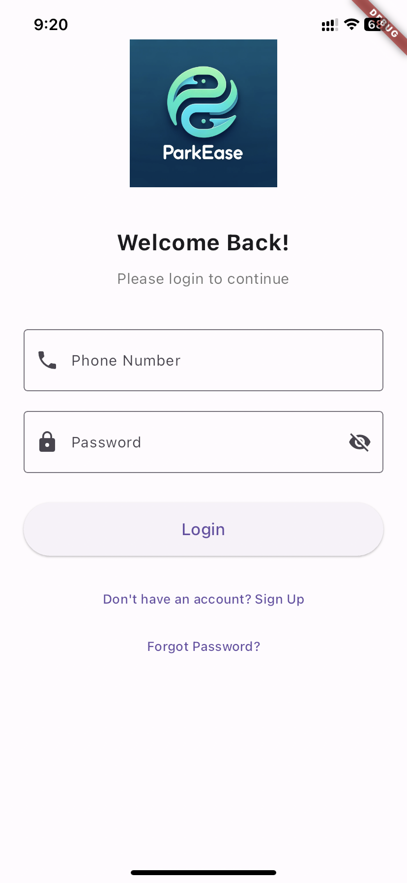
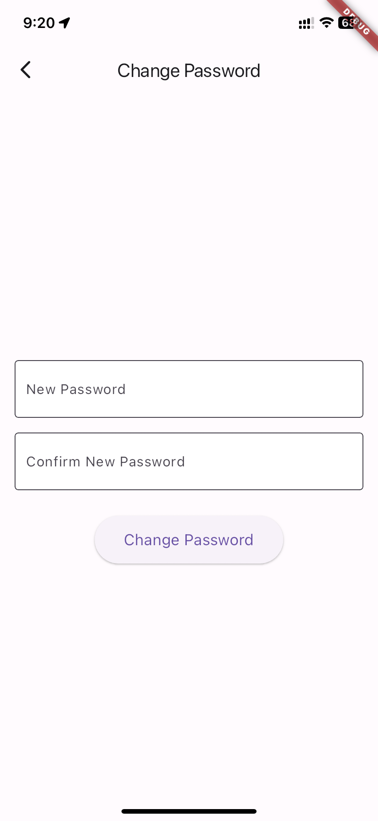
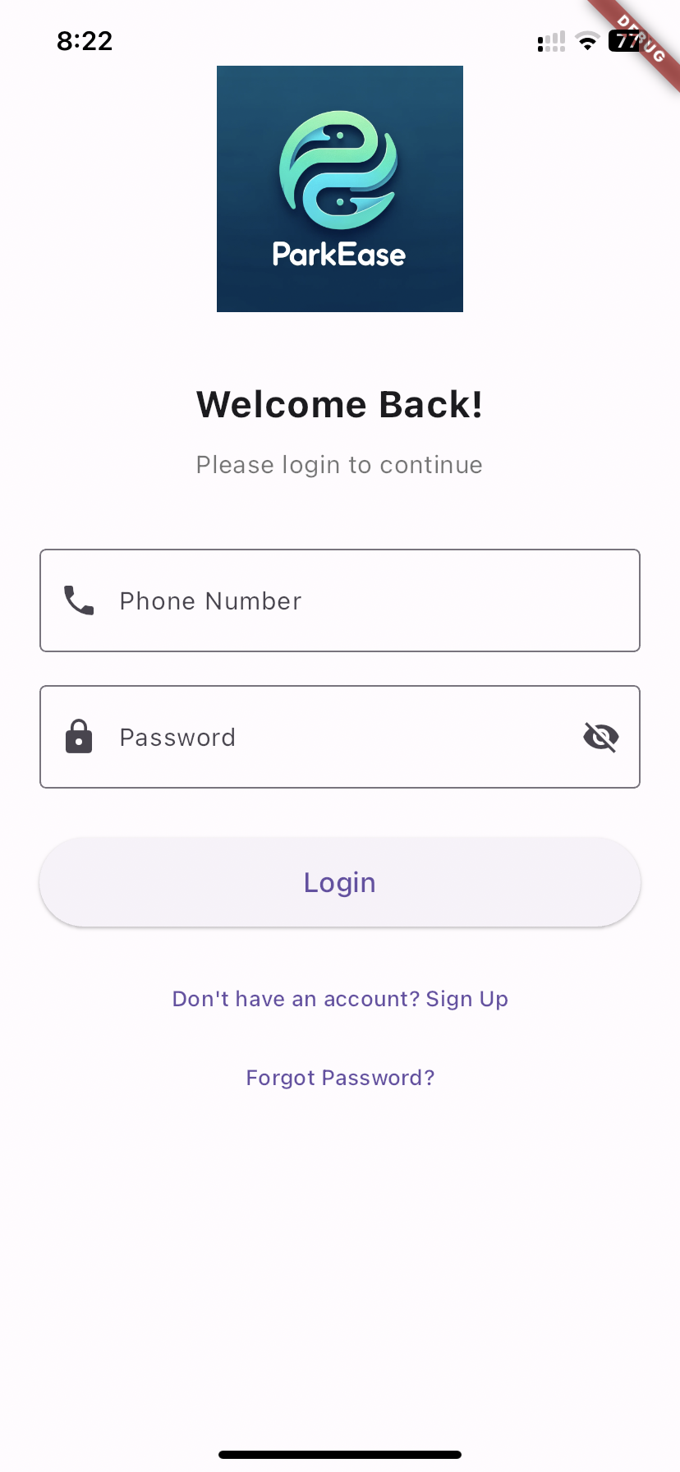
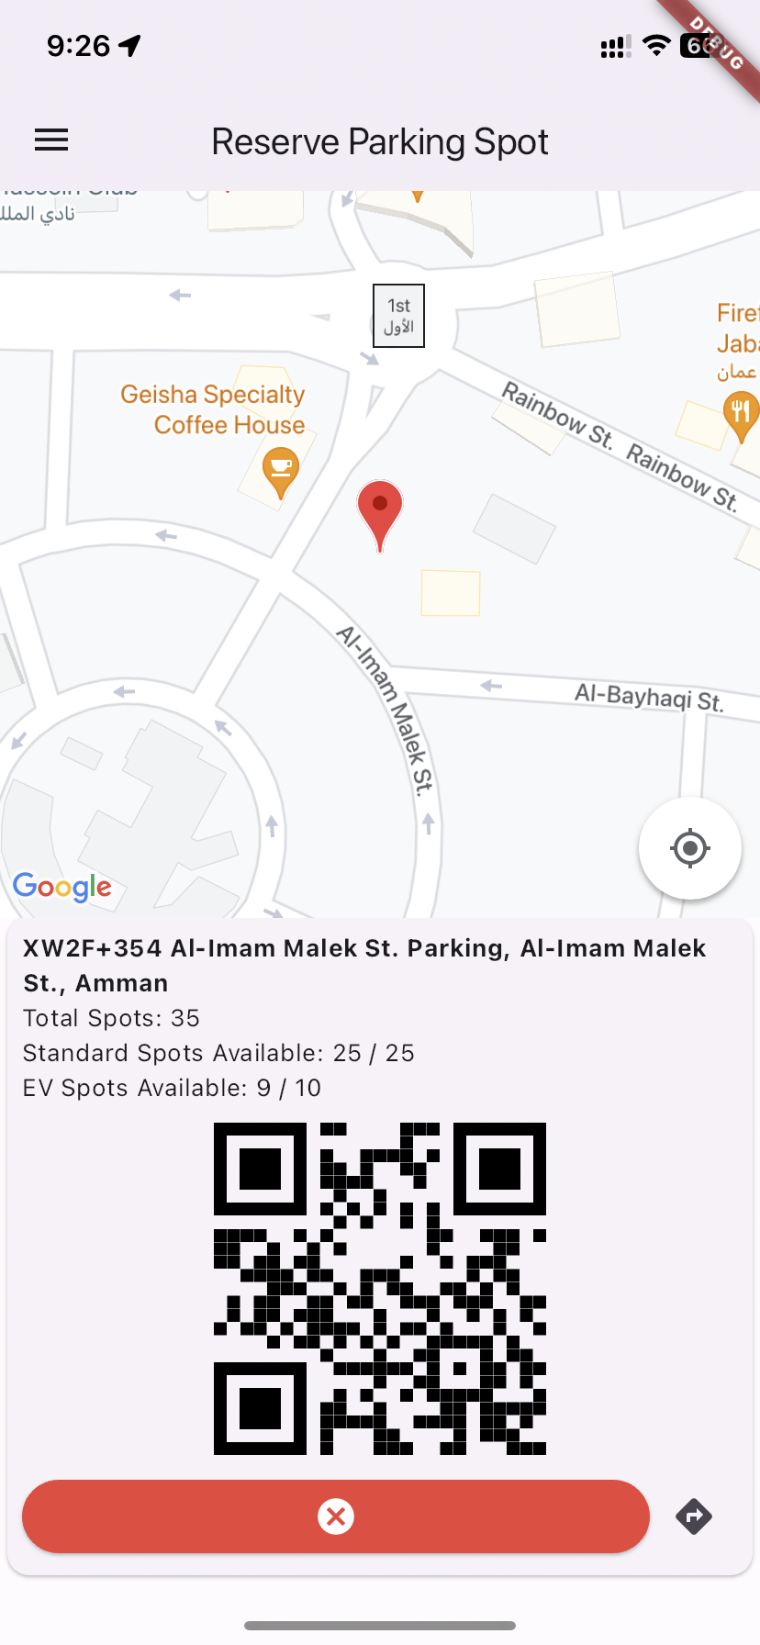
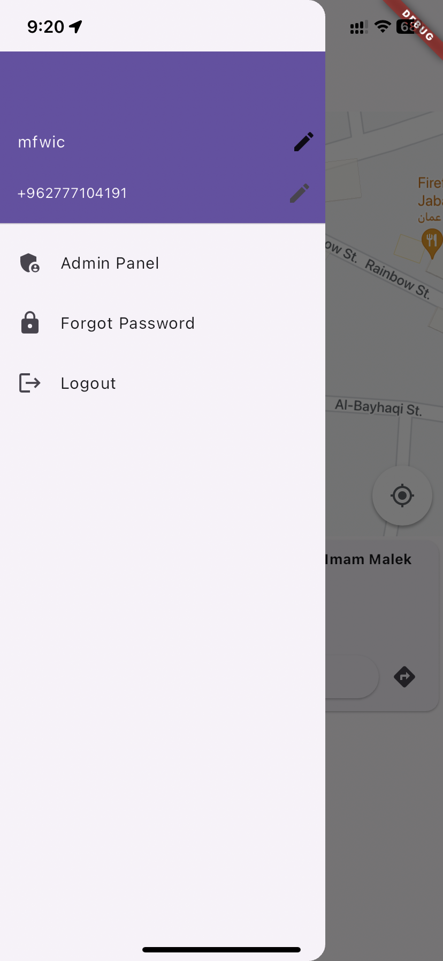
Screens of the App

Slide 11
Limitations and Challenges
1. Subscription not implemented yet
2. Sending OTP to phone requires subscription

Slide 12
Conclusion and Future Work
Conclusion: ParkEase addresses the urban parking challenges by providing real-time parking information and EV support.
Future Work:
1. Implement subscription services
2. Integrate OTP sending functionality

Slide 13
Demo

